Slide 1
The C Programming Language
Xin Fan 樊 鑫
xin.fan@ieee.org

Slide 2
About the course
Instructor: Xin Fan, xin.fan@ieee.org QQ: 1323576160
Teaching assistants (TAs):
Zhuoxiao Li (李卓宵), 848468694
Xinyu Chen (陈馨雨), 724028898
Deyun Lv(吕德运), 164237982;
Office hours: 信息楼 311 (upon request, emails are preferred)
Slides: QQ group (XXX)
Homework submission: Practice hours
软国 Tuesday night (6-9pm) A-505
软件 Tuesday night (6-9pm) A-513
Grading: 30% (Assignments & class participation) + 70% (Final exam)

Slide 3
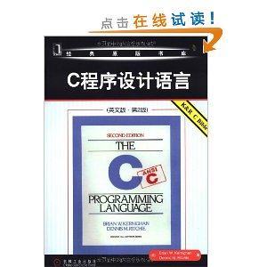
Textbook and references
Textbook
B.W. Kernighan and D.M. Ritchie. The C Programming Language. China Machine Press. “C Bible”
References
Stephen Prata. C Primer Plus. Addison-Wesley Educational Publishers Inc.
E. Balagurusamy. 《Programming in ANSIC C》. Tshinghua Press.
蒋光远、田琳琳 编. 《C程序设计快速进阶大学教程》. 清华大学出版社

Slide 4
Rules
Silent cell phones
Laptop OFF
Be absent 3 times OR late/early(leave) 5 times → absent to final exam
Questions are welcome, but one person talking
No plagiarism (copy) for homework

Slide 5
Ice breaker-Self introduction
Your name?
Your expectations for the class?
Your passion?

Slide 6
Ice breaker-An example
Xin Fan (樊鑫):
- Father and husband
- PhD from Xi’an JiaoTong University and Postdoc training in the States.
- Now a full professor at Dalian University of Technology
My expectations for the class:
- For you to learn programming and to practice technical English.
My passion: teaching and research

Slide 7
Why programming
What would computers do in 20 years (1969)?
Convert your (human) solutions to computer’s solution
Translate natural (mathematical) languages to computer languages

Slide 8
Why C Programming?
Provide efficiency compared with Java
Widely used in developing video/image and graphics processing algorithms, in which a large amount of computation is involved.
Provide low-level access to memory
Widely used in the development for embedded systems such as industrial control systems, mobile phones and networking devices.
Provide transparency (immigration) across platforms (Unix, Windows and iOS)

Slide 9
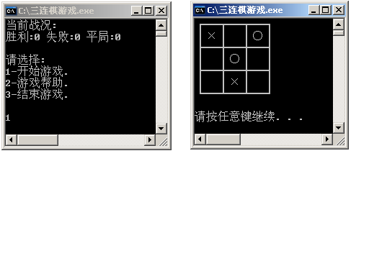
三连棋游戏
基于控制台的简单版本

Slide 10
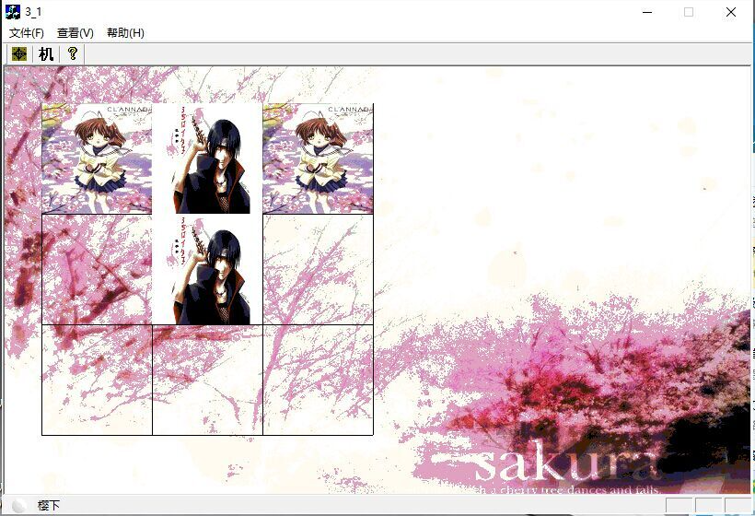
三连棋游戏
基于MFC的进阶版本

Slide 11
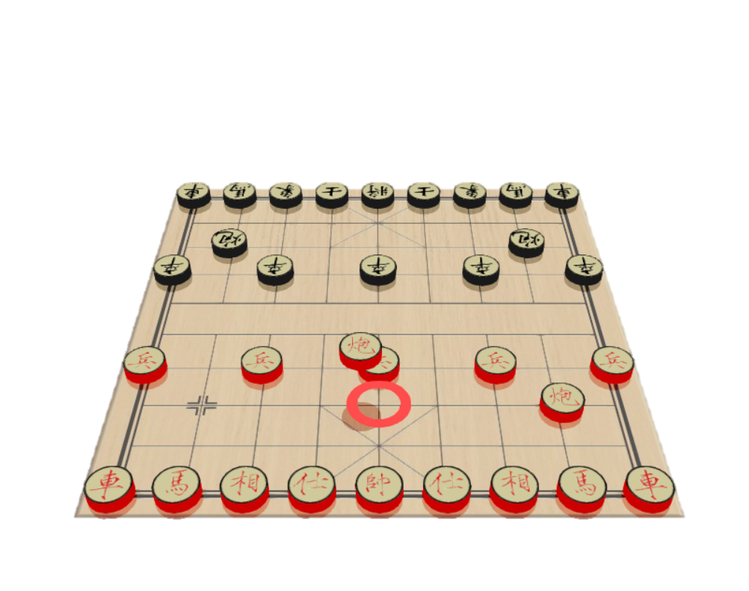
基于OpenGL的3D中国象棋

Slide 12
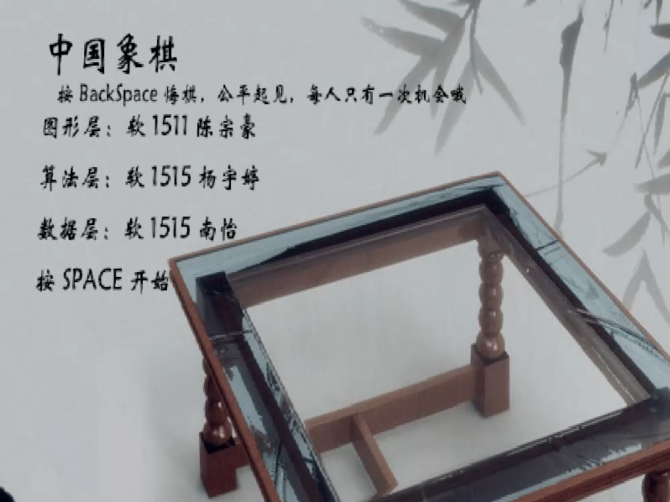
游戏录制视频
点击画面播放

Slide 13
成果2-“变脸”
关键方法：高效高精度找到多姿态面部特征点
将视频表情实时映射到目标媒介
照 片
视频
2D 角色
3D模型
真实3D人脸数据
Face to 2D Image

Slide 14
Adding two numbers
#include <stdio.h>
Chap2:
Data type
, operators
, expressions
int Add(int i1, int i2)
{
return (i1+i2);
}
Chap3: Control flow
Chap4: Functions
Chap5: Pointers and arrays
main ()
{
Chap6: User-defined types
Chap7: Input and output
int x, y, z;
x = 5;
y = 10;
z = x + y;
z = Add(x, y);
User-defined functions
if (z >0)
printf(“The sum is positive: %d”, z);
Library functions
else
printf(“The sum is non-positive: %d”, z);
}
Main function: a stand alone program has and only has ONE main function.

Slide 15
Program structure
A program consists of one or more functions, one of which must be the main function main()
#include <stdio.h> ------ file header
int main(void) ------ function header
{
int q; ------declaration statement
q=1; ------assignment statement
printf("%d is neat. \n", q); ------function call
return 0; ------function return
}
Function body

Slide 16

Main functions
The main is a part of every C program. C permits different forms of main statement. Following forms are allowed.
No arguments, nor return value
main()
void main()
main(void)
void main(void)
No arguments, but returns an integer
int main()
int main(void)
Two arguments
int main (int argc, char *argv[])

Slide 17
Developing cycle of C
Edit
Compile
Link
Execute
Edit
Write readable texts and save as files named after ‘XX.c’.
Compile
Convert to object files ‘.obj’ that are binaries (0101).
Link
Link ‘obj’ files and library files together to an executable file (.exe).
Execute (test)
Run the EXE file and debug (find and correct errors).

Slide 18
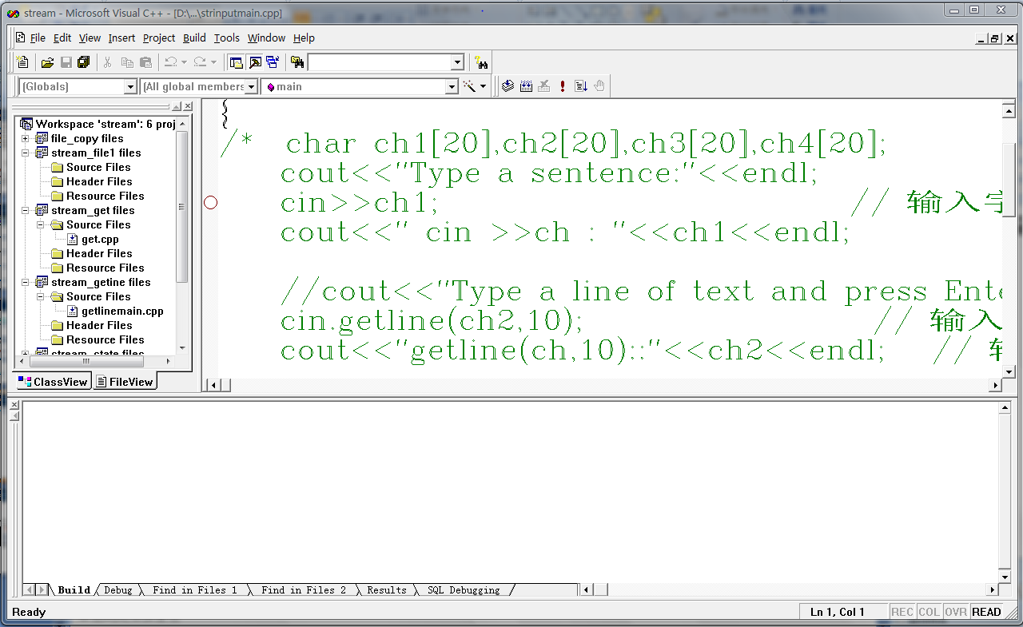
Using Integrated Development Interface (IDE)
Write and test ‘Hello world program’ using Visual C++
IDE Windows
Menu
Caption bar
Toolbars
Workspace window
Editing widnow
Output window
Status bar

Slide 19
Workspace and projects in VC
Workspace (Collection of related projects)
Project
Project
…
main() function
main() function
A stand alone program
User-defined functions
User-defined functions
Library functions

Slide 20
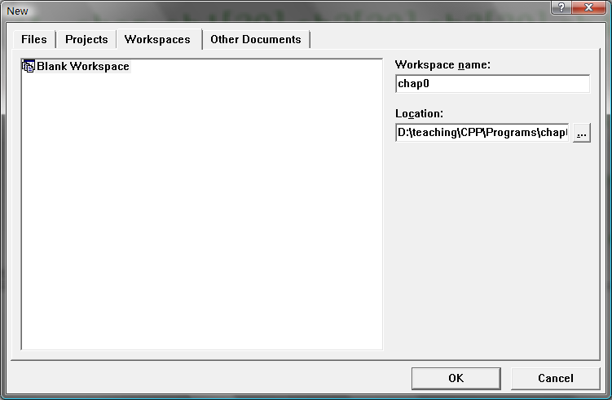
Create a workspace and project
File → new (Ctrl+N)→ ‘Workspace’ tab

Slide 21
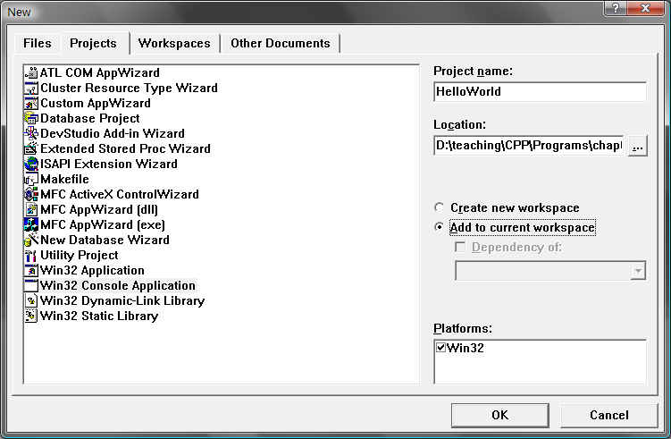
Create a workspace and project
File → new (Ctrl+N)→ ‘Projects’ tab
‘Win32 Console Application’

Slide 22
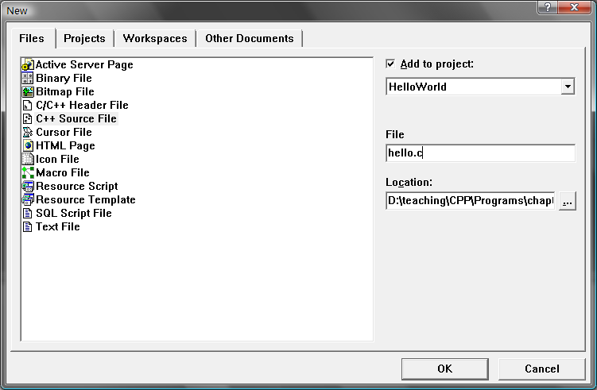
Create source files
File → new (Ctrl+N)→ ‘Files’ tab
‘C++ Source File’
Type in a name ending with ‘.c’

Slide 23
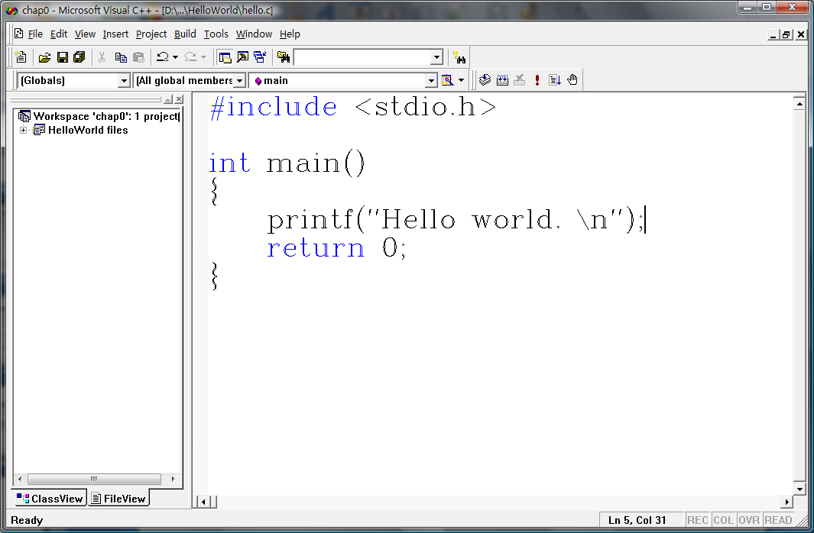
Type in programs

Slide 24
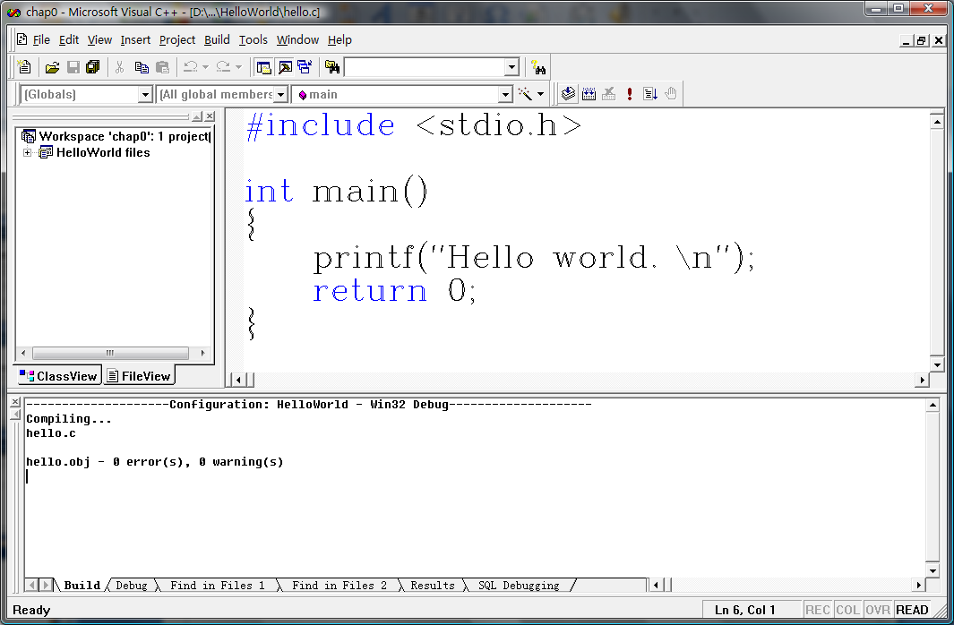
Compile
Build → Compile Filename.c (Ctrl+F7)
Click ‘compile’ button in ‘Build bar’

Slide 25
Link
Build→ Build Projectname.exe (F7)
Click ‘build’ button in ‘build’ bar

Slide 26
Execute
Build→ Execute Projectname.exe (Ctrl+F5)
Click ‘Execute’ button in ‘build’ bar

Slide 27
Flow chart of developing C
Start
Edit
.C
Source Program
Compile
Y
Errors?
.OBJ
Object Program
N
System Library and Other Object Program
Link
Y
.EXE
Executive Program
Errors?
N
Execute
N
Result Right？
Y
Process
End

Slide 28
Bugs and Debugging
Syntax errors
Syntax errors of English
I loves C.
Joy C loves.
Syntax errors of C
#include <stdio.h>
int main(void)
{
int n, int n2, int n3;
n=5;
n2 = n*n;
n3=n2*n2;
printf("n=%d, n squared =%d, n cubed=%d", n, n2, n3)
return 0;
}

Slide 29
Bugs and Debugging
Semantic errors
Semantic errors of English
Joy loves C. -- correct
C loves Joy.
Syntax errors of C
#include <stdio.h>
int main(void)
{
int n, n2, n3;
n=5;
n2 = n*n;
n3=n2*n2;
printf("n=%d, n squared =%d, n cubed=%d", n, n2, n3);
return 0;
}

Slide 30
Bugs and Debugging
Brain debugger
int n, n2, n3; --Variable initialization
n=5; --Variable n set to 5
n2 = n*n; --Variable n2 set to n squared
n3=n2*n2; --Variable n3 set to n2 squared
?
?
?
n
n2
n3
5
?
?
n
n2
n3
5
25
?
n
n2
n3
5
25
625
n
n2
n3
Tip: use printf wherever necessary

Slide 31
Bugs and Debugging
Computer debugger
Set break point
Run step by step (F8) or ‘Step into’
Run to cursor
Check memory
…
Tip: read the manual of IDE or just try

Slide 32
Exercise - 1
Consider the following program
#include <stdio.h>
int main(void)
{
int a, b;
a=5;
b=2; /*line 7*/
b=a; /*line 8*/
a=b; /*line 9*/
printf(“%d, %d\n", b, a);
return 0;
}
What is the program state after line 7? Line 8? Line 9?

Slide 33
Exercise - 2
Consider the following program
#include <stdio.h>
int main(void)
{
int x, y;
x=10;
y=5; /*line 7*/
y=x+y; /*line 8*/
x=x*y; /*line 9*/
printf(“%d, %d\n", b, a);
return 0;
}
What is the program state after line 7? Line 8? Line 9?

Slide 34
Homework
Read Chapter I up to 1.9
Type in the program in 1.6, run and test.
Finish exercises 1-4 and 1-15 in Chapter I.

